Slide 1
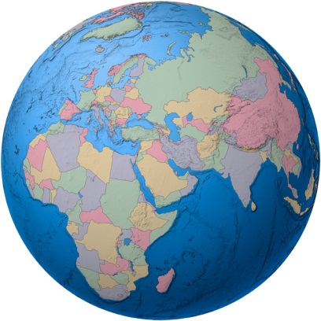
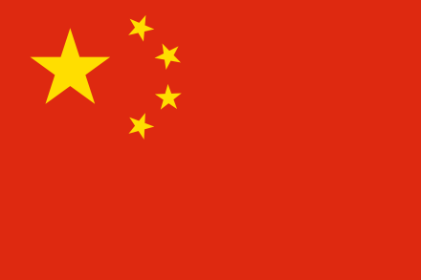
CHINA STUDY CIRCLE
Session # 14 (March 8 2018)
MONTHLY UPDATE
Islamabad’s Informal
Fourteen Session
Belt & Road : An overview of 2017
Tatheer Zahra Sherazi

Slide 2
Belt & Road : An overview of 2017
It was put into a UN resolution
China’s official portal for B& R was launched in form of online web
7 more Free Trade Zones were set up
(The new FTZs opened on 1 April 2017, bringing the total number of FTZs to eleven)
B & R forum for International Cooperation was held in Beijing(BARF)
The Asian Financial Cooperation Association was inaugurated AFCA (Association is a regional financial cooperation organization made up by small and medium-sized banks and non-bank financial institutions.)

Slide 3
…………………………
4 FTAs were signed with different countries
27 new members joined AIIB
17 projects signed under Silk Fund
B & R was added to CPC consortium

Slide 4
Belt and Road went global
XI mentioned Belt and Road word 132 times
B & R was mention by 2.7 every days
In 2017 46 countries joined the B & R friendship circle
Till the 2017 , China signed 100 corporation agreements with 86 countries and international organizations
It given rise new concepts
Silk road in Air
Silk road on Ice
Digital silk road

Slide 5
Belt and Road Operations
Blue economic passage
China-Europe freight train made nearly 7000 trips
Seven mega projects were completed
China-Mynamra oil pipeline
Mobasa-Narobi Railway
The veitnam-China friendship Palace
The port Qasim Coal project
The Yamal LNG project
19 mega projects were put into operation
The Hub coal project
17 mega projects started construction
Karoot hydro power station

Slide 6
THANK YOU

